Slide 1
Library Privacy 101
Tucker Taylor
@tuckytaylor
November 2018

Slide 2
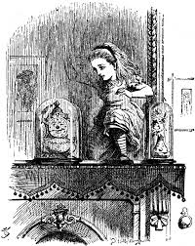
Notes:
Who am I, and how did I get here.
Hi, I’m Tucker Taylor. I’ve worked as head of circulation at USC for a little under 30 years. I’m super excited to be stretching out into this new area for me. Maybe some of you have talked to me before about my other two loves, copyright and open access. I’m also the chair of the Scholarly Communications Interest Group for SCLA if anyone has any interest in those issues, please hit me up after. Privacy is a little out of my normal comfort zone, but it’s been a large part of my job the entire time, so in a way it’s a return home. When I started my job, one of the first things I did was clean up a bunch of issues we had around privacy. Purging old patron data, eliminating patron postcards for overdues, shredding old old slips,making sure the copier was not saving old scans. We eventually added video surveillance, so there were decisions around that. So in short, same stuff libraries have been doing forever, just doing the work to make patron data safe. I remember the first time I saw a vendor’s sign in for an ebook, I almost had a hissy fit. I remember asking what was going on with the data but not being able to get either interest or an answer. I kinda chalked it up, unfairly I’m sure, to circulation people being braver than our other sorts of librarians. But I had plenty to do on my own so I decided it was someone else’s problem. When I started doing copyright and then open access presentations around the state, I immediately started getting about privacy because people conflated these issue, and I do conceded they are indeed related. So I guess I’m tired of not having good answers to questions, as well as realizing that it’s everyone’s job including me, so I need to stop playing little red hen and get to work. This is my first time presenting on these issues, so any feedback, particularly ways to make it better, is appreciated.

Slide 3
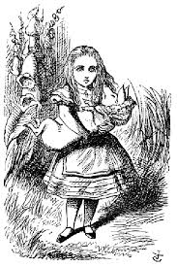
So what is Library Privacy?
Circulation record privacy
Network encryption
Public workstation setup
Catalog search security
Patron’s individual needs
Vendor data
Social network issues
Web searching
Advocating for our patrons
Understanding the laws
Mobile privacy
Student/children privacy
Notes:
Get the group to tell you what they think some library privacy issues are

Slide 4
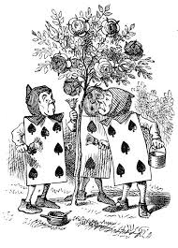
So why have we not fixed it?
“Privacy is dead”
Laws are complicated
Technology is complicated
No one is responsible
Patrons are not complaining
It’s a lot of work
Libraries don’t have a lot of power
Notes:
Ask the group to tell you why we have not fixed it yet

Slide 5
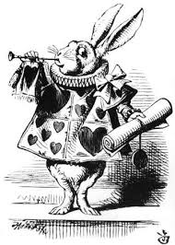
So what will we talk about today?
Basic overview of issues
What we can do for our library
What we can do for our patrons

Slide 6
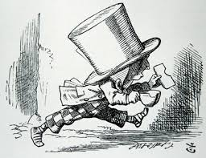
So what are the issues?
Old school
Legal issues
Technology
Awareness/Time

Slide 7
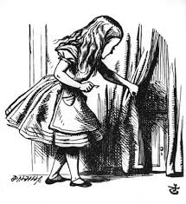
Old School
Paper patron records
Non-cloud ILS’s
Spaces
Photocopiers/Scanners
Video surveillance
Notes:
Are you saving data longer than you need to? Do you save patron checkout records? Do you shred hold slips and other internal documents that have patron data such as search lists? Are your workstations so close together that people can see someone else type in a password? Are you clear about who is videoing them and what you do with it? What about scanner and photocoper memory?

Slide 8
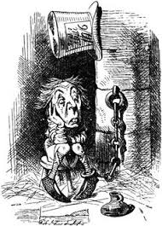
Legal Issues
4th Amendment
Library legislation
SC Library Record Confidentiality Law
Patriot Act
Ferpa, etc….
Right to be forgotten
Internet Law Soup
Capitalism!
Notes:
The confidential records may not be disclosed except to persons acting within the scope of their duties in the administration of the library or library system or persons authorized by the library patron to inspect his records, or in accordance with proper judicial order upon a finding that the disclosure of the records is necessary to protect public safety, to prosecute a crime, or upon showing of good cause before the presiding Judge in a civil matter.

Slide 9
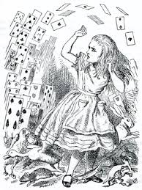
Technology
Workstations/software
HTTPS/Encryption
Librarian core competencies
Patron information needs
Databases/Vendors
Mobile Technology
Notes:
Library Freedom Institute
Data Privacy Project

Slide 10
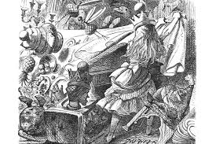
Awareness/Time/Resources/Priorities

Slide 11
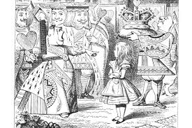
So why us?
Information professionals
Patrons can’t sign contracts with our vendors
Help the powerless
Good advocacy
Notes:
Only sources of internet access for some,

Slide 12
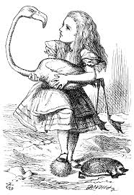
What can a library do?
Privacy Audit
Privacy Policy
Educate Staff
Promote Privacy
Advocate for Privacy

Slide 13
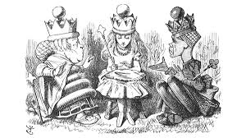
What to do
Privacy audit
Notes:
What is a privacy audit

Slide 14
Privacy Audit (ALA)
A privacy audit provides a library opportunity to examine:
how privacy matters are handled at all levels
the flow and storage of data
the role data plays within the organization
staff training about privacy matters
existing and needed privacy policies
REMEMBER: This is a process, not a one-shot project, AND it will scale differently, depending on your library.
San Jose Public Library Privacy Audit
Notes:
http://www.ala.org/advocacy/intfreedom/webinar/cpw18 webinar

Slide 15
What Does the ALA Privacy Audit Cover?
E-book Lending and Digital Content Vendors
Data Exchange Between Networked Devices and Services
Public Access Computers and Networks
Library Websites, OPACs, and Discovery Services
Library Management Systems
Students in K-12 Schools

Slide 16
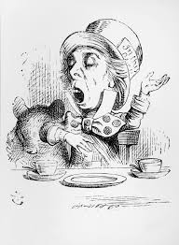
ALA Privacy Toolkit
Privacy & the Law
Privacy Principles
Writing a Privacy Policy
Privacy Audits
Implementing Policies and Procedures
Talking Points
Answering Tough Questions
What ALA is Doing

Slide 17
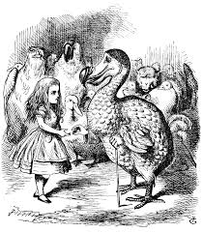
Privacy Policy
San Jose Public Library Privacy Policy
Commitment to Privacy
What information do we collect?
Records retention
List out to vendor policies
Who has access to information
Protecting children’s privacy
Website and Public Computers
Cookies, HTTPS, public computers, other data security
Surveillance
Law enforcement

Slide 18
Educate Staff
Teaches librarians how information travels and is shared online, what risks users commonly encounter online, and how libraries can better protect patron privacy.

Slide 19
Educate Staff
Library Freedom Project
Library Freedom Institute

Slide 20
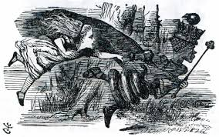
Promote and Advocate Privacy
Choose Privacy Week (May)
Programming in a box
Host a speaker
Libguide
Workshops
Talk to your board or governing body
Join SCLA
Ask your vendors about their policies
Be more transparent with your users

Slide 21
Educate Users
Lebanon Public Library
Library Freedom Project
Online, mobile, kids, librarians, and TOR project
EFF SSD
Notes:
malware, password manager, master password, https, tor, encryption, social media, mobile, 2factor authentication, updating passwords, browser, extension, email, threat assessment

Slide 22
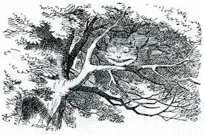
Today in Awesome
Privacy Badger
HTTPS Everywhere
CERTBOT
Duck Duck Go
TOR
EFF

Slide 23
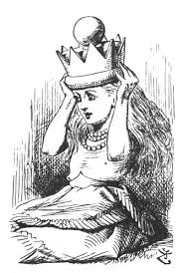
What should we do next?
Learn more
Talk about it
Try an audit
Do something- libguide, speaker, etc...
Come play with me @tuckytaylor

Slide 24
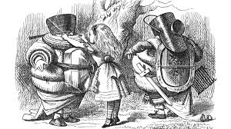

Slide 25
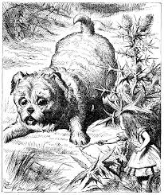
So how do I figure this out?
What do I want to protect?
Who do I want to protect it from?
How bad are the consequences if I fail?
How likely is it that I will need to protect it?
How much trouble am I willing to go through to try to prevent potential consequences?

Slide 27
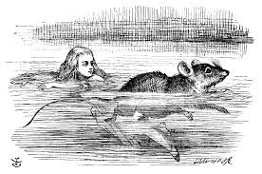
Technology
Library systems

Slide 28
Vendor Privacy
Vendor privacy policies must be available upfront and understandable to users. The library and users must be notified of changes to these policies.
SJPL List of Vendor Policies

Slide 29
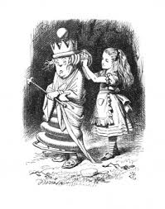
What can we do for our patrons?
Good resources
Help with questions
Keep the discussion going
Choose Privacy Week 2019 (May)
Notes:
Put up a libguide, point people to good resources, displays, bring in speakers

Slide 30
What can we do for patrons
Lebanon Public Libraries Online Self Defense
San Jose Public Library Virtual Privacy Lab

