Slide 1
FLIPPED CLASSROOM
Information Literacy Sessions with Classroom Partners

Slide 2
Partnerships Between Faculty & Students
Lectures are not necessarily conducive to “the sort of partnership between students and instructor that the best learning experiences have.”
- TALBERT, 2014

Slide 3
What is It? How Does It Work?
The Flipped Classroom is a pedagogical model in which the typical lecture and homework elements of a course are reversed.
Copyright 2012 EDUCASE. This work is licensed under a Creative Commons Attribution-Non-Commerical-NoDerivs 3.0 License. http://creativecommons.org/licenses/by-nc-nd/3.0/

Slide 4
A growing number of higher education individual faculty have begun using the flipped model in their courses
4% - Failure Rate in Biology down from 17% BEFORE using flip at Univ. of Washington in Seattle
73.7% - “C” or better in flipped General Chemistry vs. 48.4% in traditional class at Univ. of Memphis
5.1% - Increase in final exam performance
2013 UNC Pharmacy School Study
Flipped Learning in Higher Ed
Who’s Doing It?
Copyright 2012 EDUCASE. This work is licensed under a Creative Commons Attribution-Non-Commerical-NoDerivs 3.0 License. http://creativecommons.org/licenses/by-nc-nd/3.0/ Clipart Copyright 2010 Microsoft.com

Slide 5
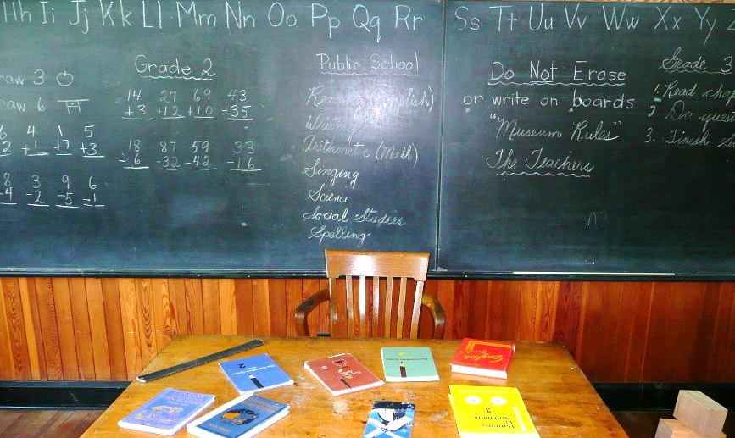
What’s the Value of Flipping a Classroom?
“The value of a flipped class is in the repurposing of class time into a workshop where students can inquire about lecture content, test their skills in applying knowledge, and interact with one another in hands-on-activities.”
- EDUCAUSE

Slide 6
Flipped Library Orientations
Spring Semester 2014

Slide 7
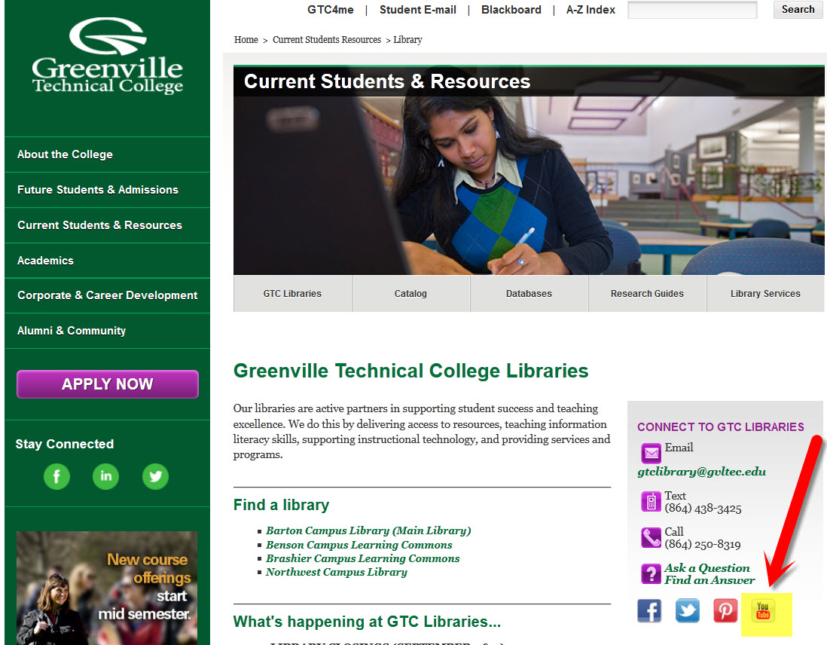

Slide 8
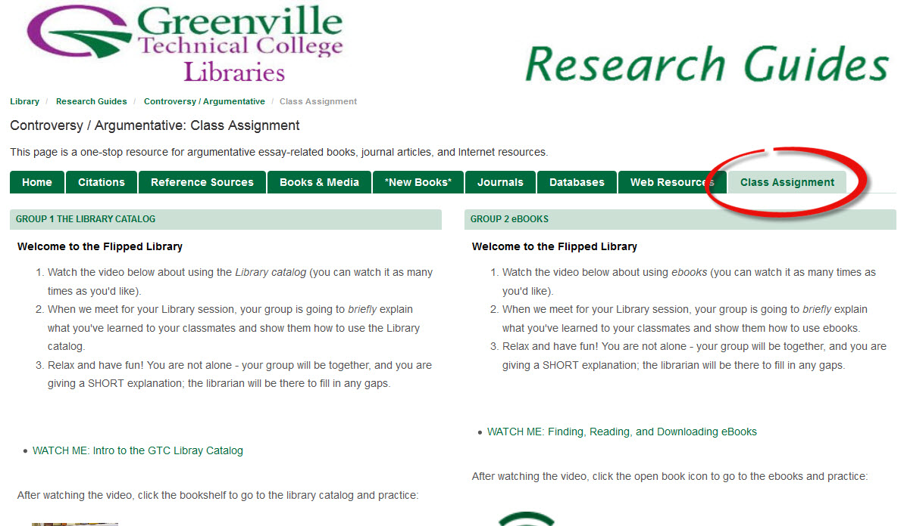

Slide 9
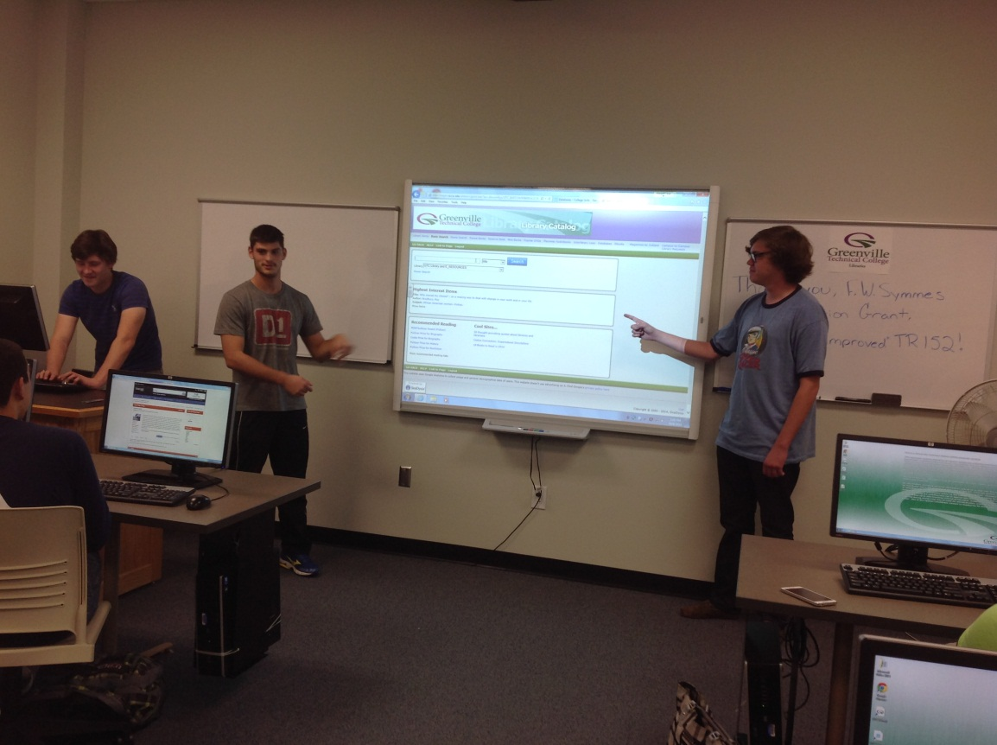
The Good, the Bad, and the PowerPoint

Slide 10
http://libguides.gvltec.edu/flipped
www.gvltec.edu/library
Off-campus database password: helpful
Mock-Flip

Slide 11
Interaction That Enhances Learning
“There is interaction between the coach [instructor] and the player [student], between different players, and between different groups of players. And through that interaction, questions get answered, others get raised – and things get learned”
- TALBERT, 2014

Slide 12
Questions?
Carole Williams, Information Literacy Librarian
carole.williams@gvltec.edu
Michelle A. Rubino, Online & Information Literacy Librarian
michelle.rubino@gvltec.edu

Slide 13
Flipping Articles & Resources
"7 Things You Should Read About Flipped Classrooms." EDUCAUSE.edu. Web. 30 Apr. 2014. https://net.educause.edu/ir/library/pdf/ELIR1302.pdf
Benjes-Small, and Katelyn Tucker. “Keeping Up With…Flipped Classrooms.” http://www.ala.org/acrl/shib_login/?q=publications/keeping_up_with/flipped_classrooms
Bergmann, Jon, et al. “The Flipped Class: What It Is and What It Is Not.” http://www.thedailyriff.com/articles/the-flipped-class-conversation-689.php
Bishop, Jacob Lowell, and Dr. Matthew A. Verleger. “The Flipped Classroom: A Survey of the Research.” 120th ASEE Annual Conference & Exposition, June 23-26, 2013, Atlanta. n.p., n.d. Web. http://www.studiesuccesho.nl/wp-content/uploads/2014/04/flipped-classroom-artikel.pdf
Brame, Cynthia J. "Flipping the Classroom." Center For Teaching RSS. Vanderbilt University Center for Teaching, n.d. Web. 30 Apr. 2014. http://cft.vanderbilt.edu/guides-sub-pages/flipping-the-classroom/
Bruff, Derek. "The Flipped Classroom FAQ." CIRTL Network. N.p., 15 Sept. 2012. Web. 30 Apr. 2014. http://www.cirtl.net/node/7788

Slide 14
Center for Instructional Technology, Duke University, “Flipping the Classroom” http://cit.duke.edu/get-ideas/teaching-strategies/flipping-the-classroom/
Flipped Learning Network: A professional learning community for teachers using screencasting in education. http://flippedclassroom.org/
Flipping the Classroom Video: from Penn State University http://youtu.be/26pxh_qMppE
Talbert, Robert. "Flipped learning skepticism: Is flipped learning just self-teaching?." Casting Out Nines. Chronicle of Higher Education. 28 Apr. 2014. Web. 30 Apr. 2014. http://chronicle.com/blognetwork/castingoutnines/2014/04/28/flipped-learning-skepticism-is-flipped-learning-just-self-teaching/?cid=at&utm_source=at&utm_medium=en
Teaching for Tomorrow Video: Flipped Learning http://youtu.be/4a7NbUIr_iQ
The Flipped Classroom FAQ. CIRTL Network Committed to advancing the teaching of STEM disciplines in higher education. http://www.cirtl.net/node/7788
Yarbro, Jessica, et al. “Extension of a Review of Flipped Learning.”
http://flippedlearning.org/cms/lib07/VA01923112/Centricity/Domain/41/Extension%20of%20FLipped%20Learning%20LIt%20Review%20June%202014.pdf

